Slide 1
DevOps Engineer
CICD Pipelines DIAGRAM

Slide 2
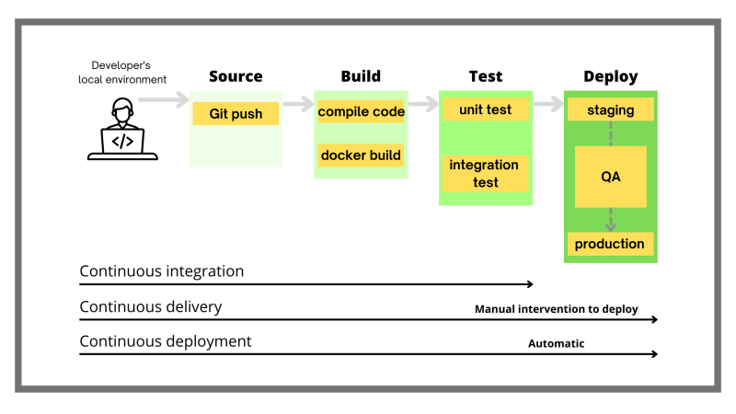
CICD Pipeline

Slide 3
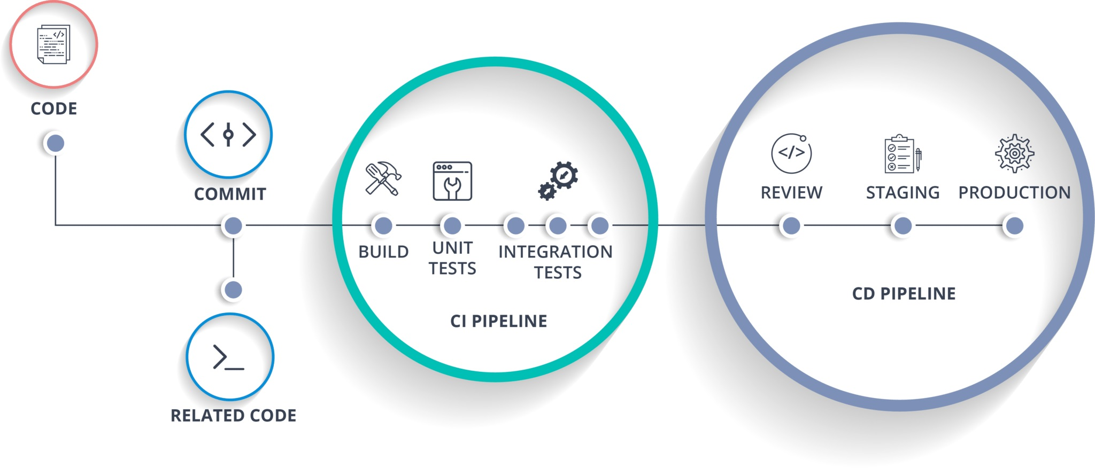
CICD STAGES

Slide 4
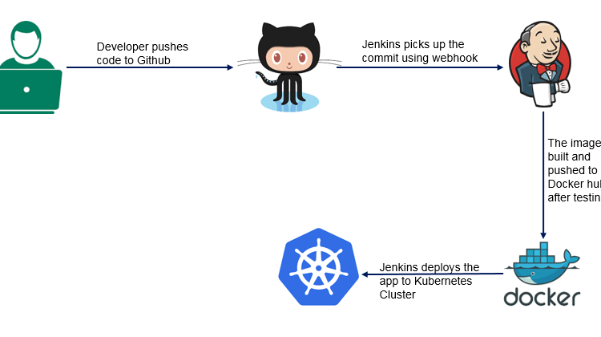
Basic CICD process diagram

Slide 5
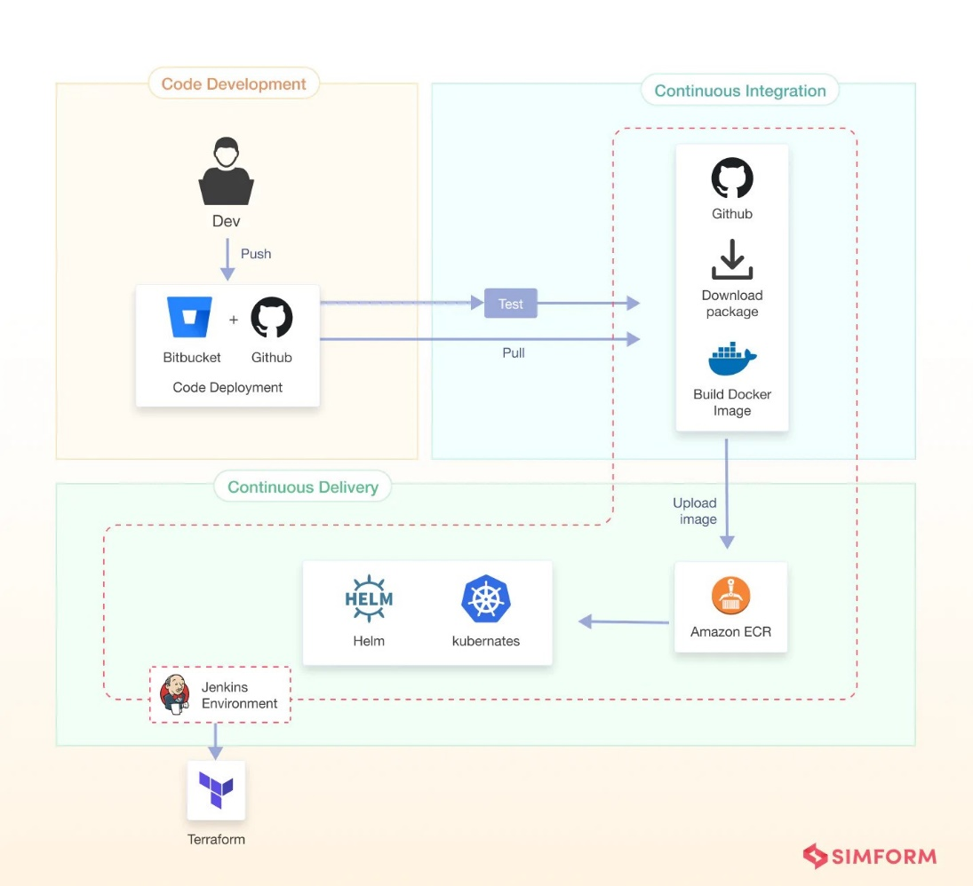
Advanced Diagram -1

Slide 6
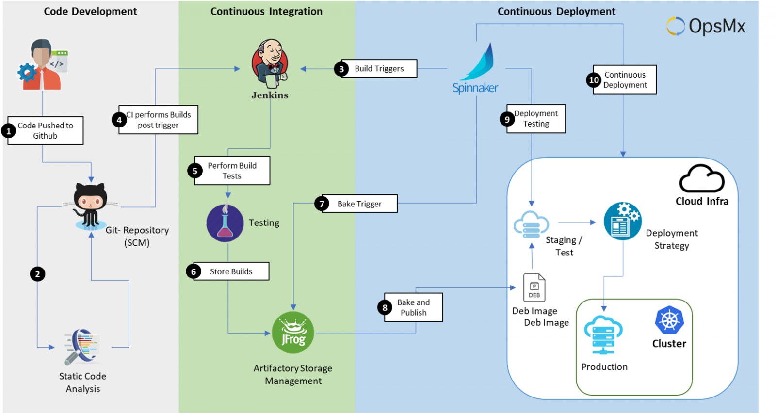
Advanced Diagram -2

Slide 7
What Needs to include ?
•Your Git tools
• CI tool(Jenkins)
•Configuration management and IaC tools (Ansible/Terraform)
•Your deployment environment with Containerization and orchestration tools (VMs/Docker/Kubernetes).
•Connectivity of each above components
•Addition to above, connectivity between your application components need to be included.
Example: If your application running on few containers, connectivity of the containers
Give a brief explanation of your diagram.
Using the online tool draw.io is recommended for drawing your diagram

Slide 8
Thank You

